Slide 1
WRITING EQUATIONS IN POINT-SLOPE FORM
Wolff
Algebra 1H

Slide 2

POINT-SLOPE FORM
Need to know:
Slope (m)
a point on the line (x₁,y₁)

Slide 3

(X,Y) VS. (X₁,Y₁)
What’s the difference?
  x and y represent any point on the line
  (x₁,y₁) represents one specific point on the line

Slide 4
GRAPHING FROM POINT-SLOPE FORM
Identify the point that you know (x₁,y₁) from the equation
Plot that point
Use slope from that point to plot more points
Draw a line through your points

Slide 5
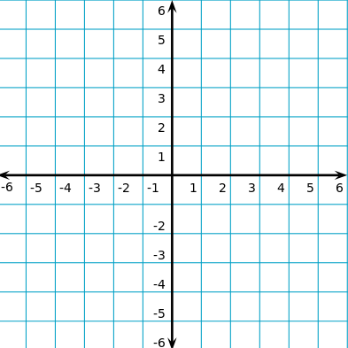
EXAMPLE: Y + 3 = 2(X + 4)
Step 1: (-4,-3)
Step 4
Step 3
Step 2

Slide 6
LET’S PRACTICE IT!☺

Slide 7
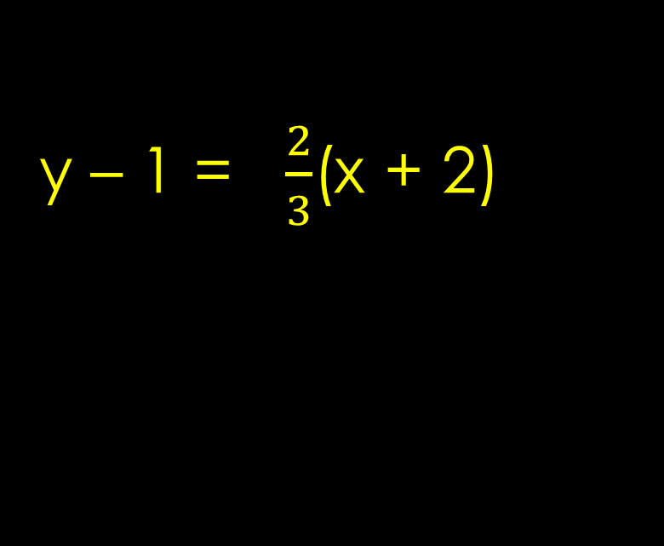
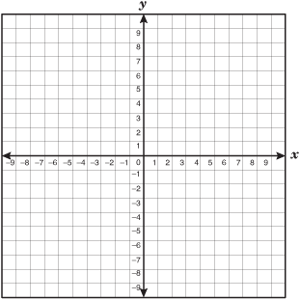
GRAPHING LINES IN POINT-SLOPE FORM

Slide 8
HOW DID YOU DO?

Slide 9
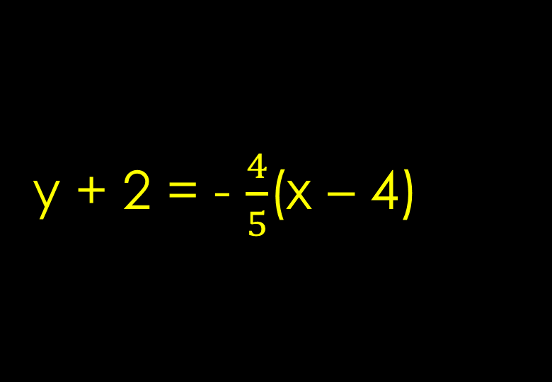
GRAPHING LINES IN POINT-SLOPE FORM

Slide 10
WERE YOU CORRECT?

Slide 11
GRAPHING LINES IN POINT-SLOPE FORM
y – 3 = –(x – 1)

Slide 12
DOES YOUR GRAPH LOOK LIKE THIS?
y – 3 = –(x – 1)

Slide 13
EXAMPLE
Write an equation in point-slope form for the line that passes through (-2,1) with a slope of -6
y – 1 = -6(x - -2)
y – 1 = -6(x + 2)

Slide 14
WRITING EQUATIONS IN POINT-SLOPE FORM
( 8, -4) and a slope of 2/3

Slide 15
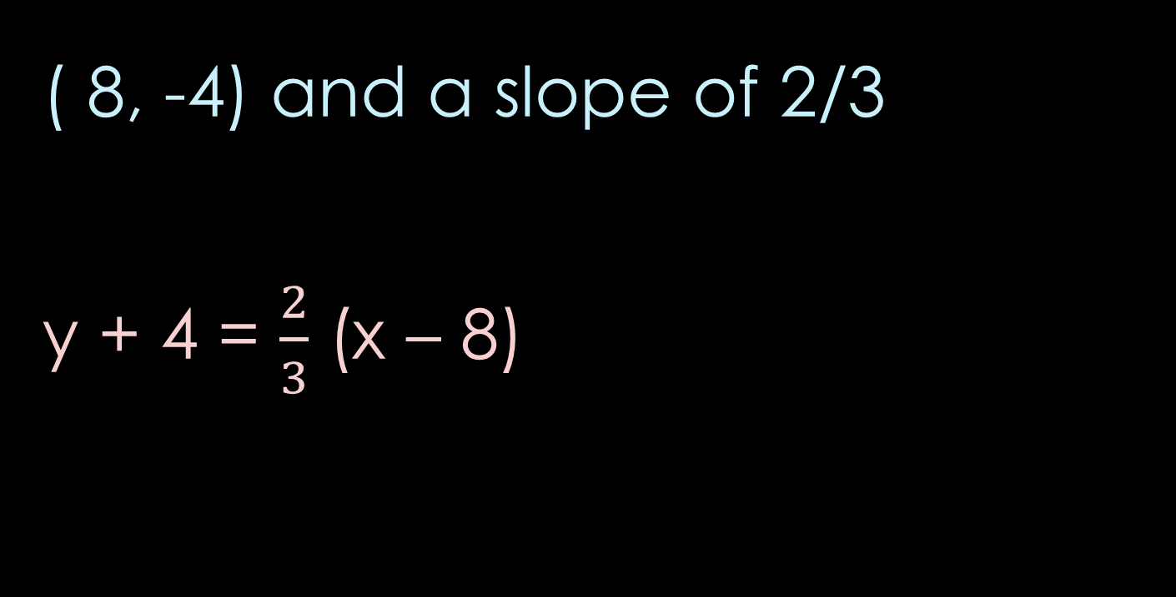
HOW DID YOU DO?

Slide 16
WRITING EQUATIONS IN POINT-SLOPE FORM
(-3, 6) and a slope of -5

Slide 17
WERE YOU RIGHT?
(-3, 6) and a slope of -5
y – 6 = -5(x + 3)

Slide 18
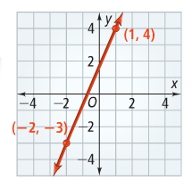
WRITING EQUATIONS IN POINT-SLOPE FORM WHEN GIVEN 2 POINTS
Use the 2 points to find slope (m)
Choose one of the points for (x₁,y₁)

Slide 19

HOW DID YOU DO?

Slide 20
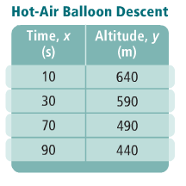

WRITING AN EQUATION IN POINT-SLOPE FORM FROM A TABLE
The table shows the altitude of a hot-air balloon during its linear descent. What equation in point-slope form gives the balloon’s altitude at any time? What equation in slope-intercept form gives the balloon’s altitude at any time? What do the slope and y-intercept represent?

